Slide 1

Bluestock Mutual Fund Analytics Capstone
End-to-End Mutual Fund Analytics | Final Presentation
Kevin Joel Velevela | BCA – Data Science
PYTHON
SQL
POWER BI
PANDAS
PLOTLY

Slide 2
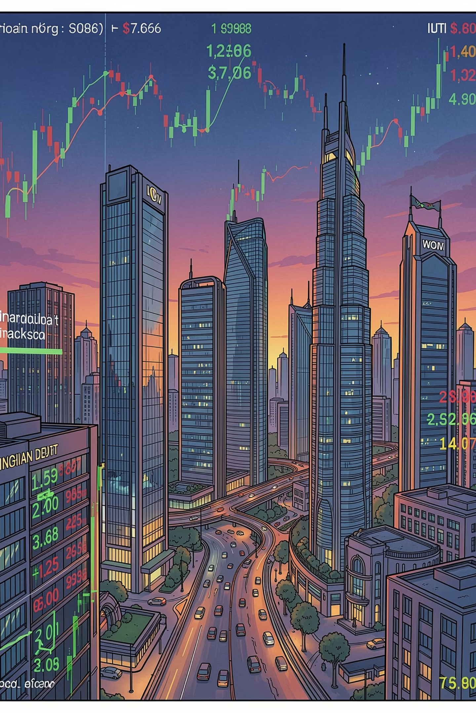


PROJECT CONTEXT
Why This Project?
India's mutual fund industry manages over ₹50 trillion in AUM, yet investors lack accessible quantitative tools to objectively compare the 40+ available schemes. SIP discontinuity, B30 market gaps, and fragmented data remain largely unaddressed — creating a critical need for a unified analytics platform.
The Problem
₹50+ trillion AUM with limited retail analytics access
No objective framework to compare 40+ schemes
SIP discontinuity and B30 market gaps unaddressed
The Objective
Build an end-to-end analytics platform covering ETL, EDA, risk metrics, and BI dashboarding — delivering actionable mutual fund intelligence for investors and analysts alike.

Slide 3

ARCHITECTURE
Data Sources & Project Architecture
The project integrates 10 structured datasets — Fund Master, NAV History, AUM, SIP Inflows, Transactions, Portfolio Holdings, Benchmark Indices, and more — all validated against AMFI standards. Live NAV data is sourced via the mfapi.in API, ensuring real-time accuracy throughout the pipeline.
Raw CSV
ETL Pipeline
Star Schema
Analytics Engine
The pipeline flows seamlessly from ingestion through transformation to visualisation, with a star schema in SQLite enabling efficient analytical queries across all fund schemes and investor segments.

Slide 4

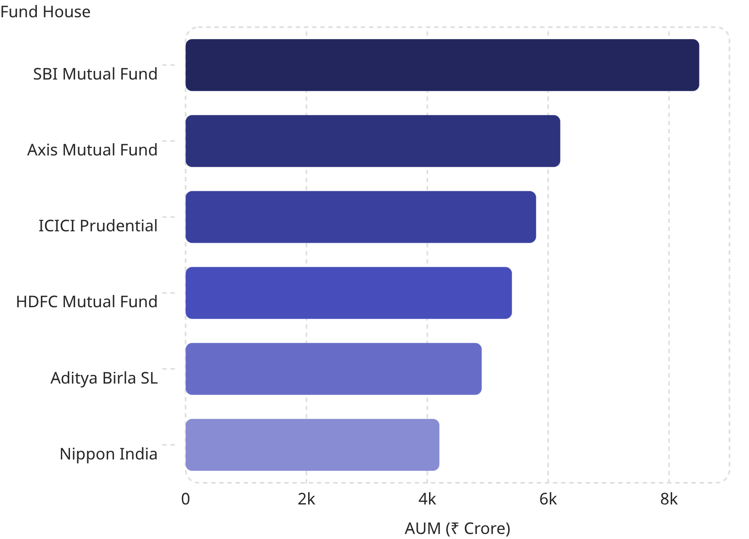
EXPLORATORY DATA ANALYSIS
What the Data Revealed
Key EDA Findings
Top Fund Houses by AUM
2023 Bull Market Rally
Strong NAV growth observed across all equity schemes, reflecting favourable market conditions and investor confidence.
SBI MF Dominates AUM
SBI Mutual Fund holds the highest total AUM across all fund houses, cementing its position as the industry leader.
SIP Growth Trajectory
Consistent upward SIP trend from 2022–2025, with a notable peak in H2 2024 driven by new investor cohorts.

Slide 5
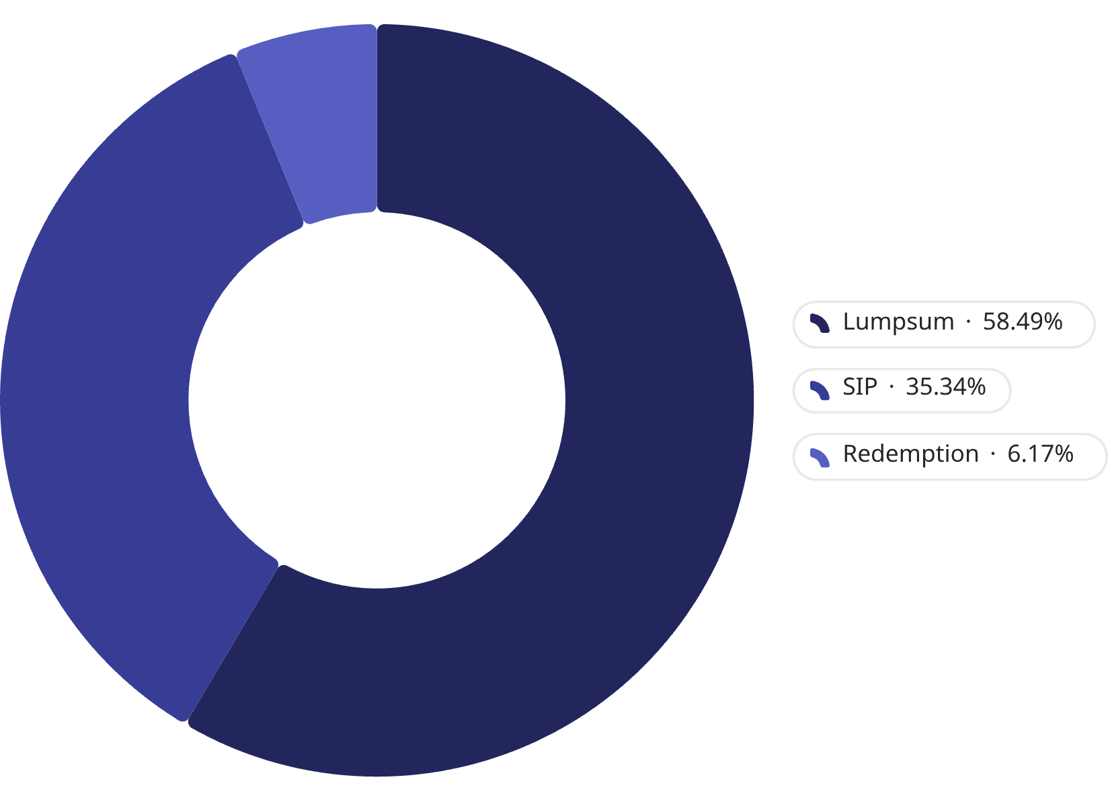
EXPLORATORY DATA ANALYSIS
Investor Behaviour Insights
Transaction Type Distribution
What the Numbers Tell Us
👥 Demographics
🗺️ Geography
The 25–35 age group forms the largest investor segment, reflecting growing financial literacy among millennials.
T30 cities lead in volume, but B30 cities show accelerating growth — a key untapped market opportunity.
📂 Folio Expansion
Significant folio count expansion in 2023–2024, driven by new investor onboarding and digital channels.

Slide 6
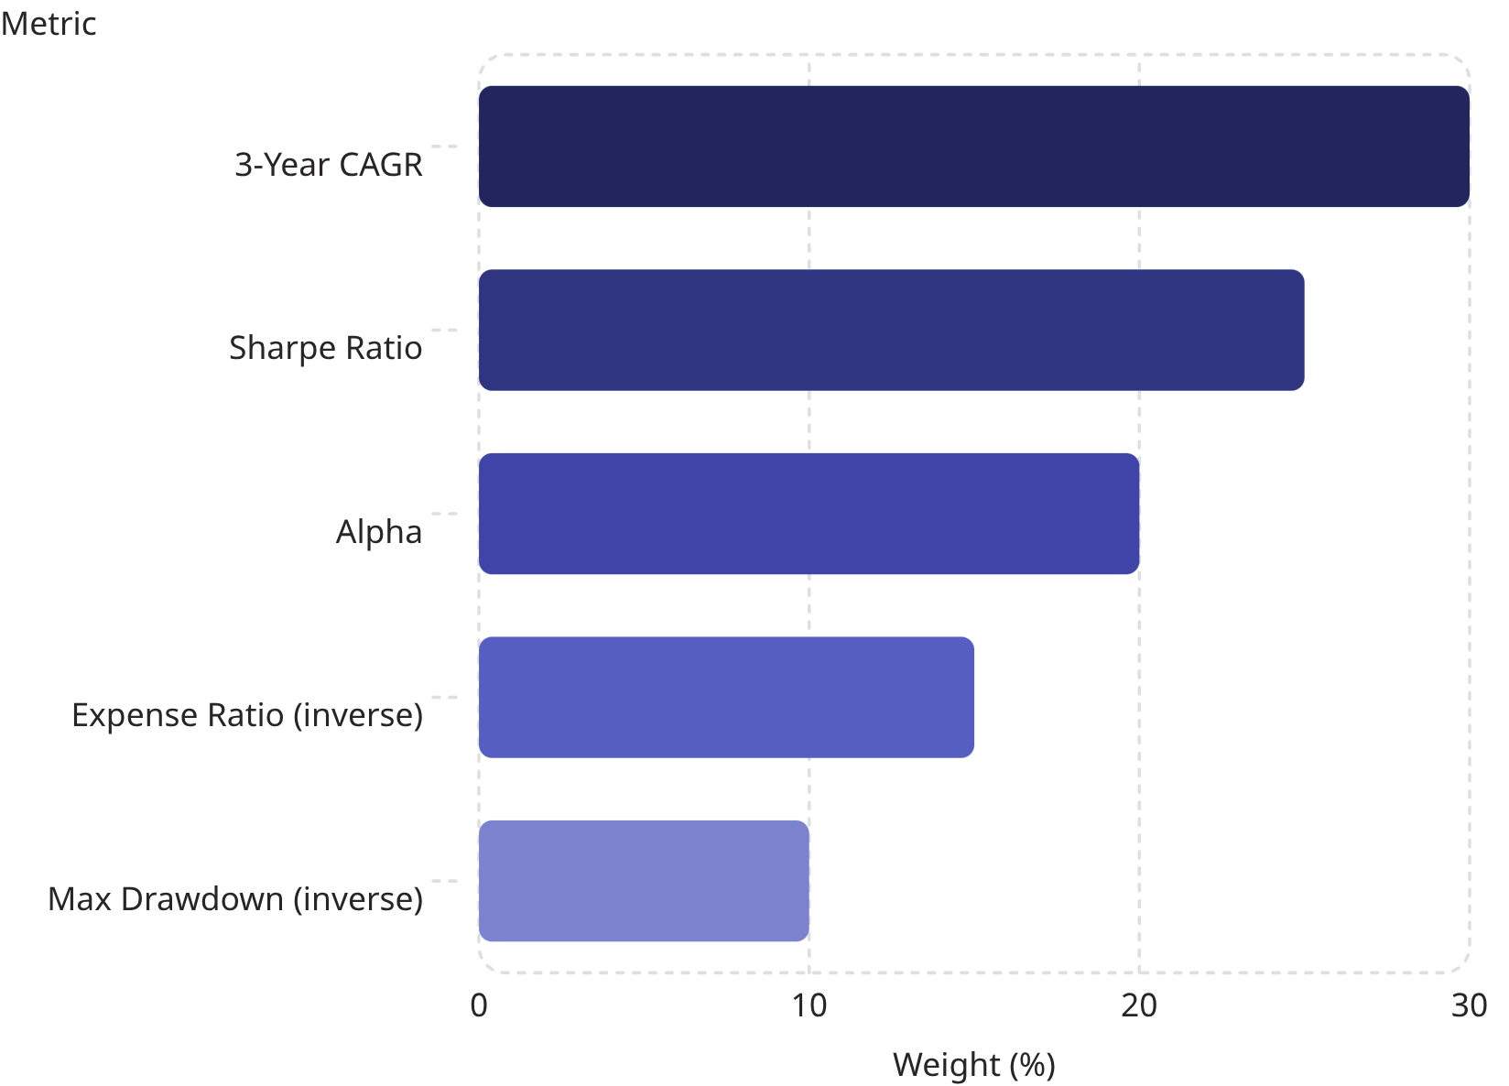

PERFORMANCE ANALYTICS
Quantitative Performance Framework
Metrics Computed
Composite Scorecard Weights
CAGR
Sharpe Ratio
Annualised returns over 1, 2, and 3-year horizons
Risk-adjusted returns using 6.5% risk-free rate
Sortino Ratio
Alpha & Beta
Downside risk-adjusted performance measure
Relative performance vs NIFTY100 benchmark
Max Drawdown
Peak-to-trough decline for downside risk
All 40 schemes ranked on a unified 0–100 composite score, enabling objective cross-category comparison.

Slide 7






PERFORMANCE ANALYTICS
Top Fund Findings
Mid-Cap Alpha Leaders
Mid-cap funds generated the highest Alpha vs NIFTY100, outperforming both large-cap and small-cap peers on a risk-adjusted basis.
Small-Cap VaR Risk
Small-cap funds — notably SBI, Axis, and ABSL Small Cap — exhibited the highest Value-at-Risk, signalling elevated downside exposure.
ARIMA Forecasting
ARIMA time-series models applied to top NAV histories, providing forward-looking NAV projections for investment planning.
Tracking Error
Tracking Error calculated against both NIFTY50 and NIFTY100, quantifying active management deviation for each scheme.
All 40 schemes ranked on a unified 0–100 composite scorecard — enabling apples-to-apples comparison across categories, risk profiles, and fund houses.

Slide 8




ADVANCED ANALYTICS
Risk & Behavioural Analytics
VaR & CVaR
Rolling Sharpe
Small-cap funds showed the most negative 95% VaR, with CVaR confirming severe tail-risk exposure during market stress periods.
A 90-day rolling window reveals distinct market cycle patterns, highlighting periods of superior and deteriorating risk-adjusted performance.
SIP Continuity
HHI Concentration
Only 2.20% of investors maintain healthy SIP gaps — a critical retention challenge and major opportunity for nudging interventions.
Axis Bluechip Fund recorded the highest Herfindahl-Hirschman Index, indicating concentrated portfolio holdings and elevated idiosyncratic risk.

Slide 9

POWER BI DASHBOARD
Interactive BI Dashboard
Industry Overview Page
Fund Performance & Investor Analytics
KPI cards displaying total AUM, SIP Inflows, Active Schemes, and Fund Houses alongside an AUM trend line and fund house comparison bar chart — providing instant industry-level context.
Multi-page dashboard featuring a Risk vs Return scatter plot, NAV trend visualisations, state-wise transaction heat map, and age-group investment breakdowns — enabling drill-down analysis at scheme and investor level.

Slide 10
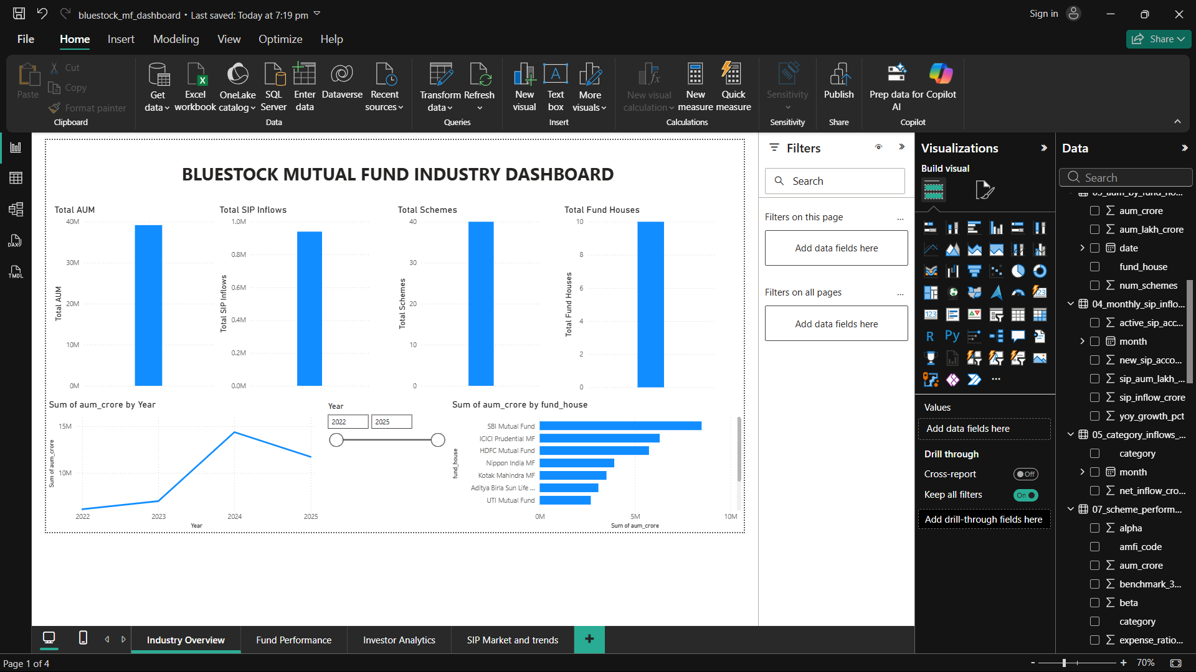
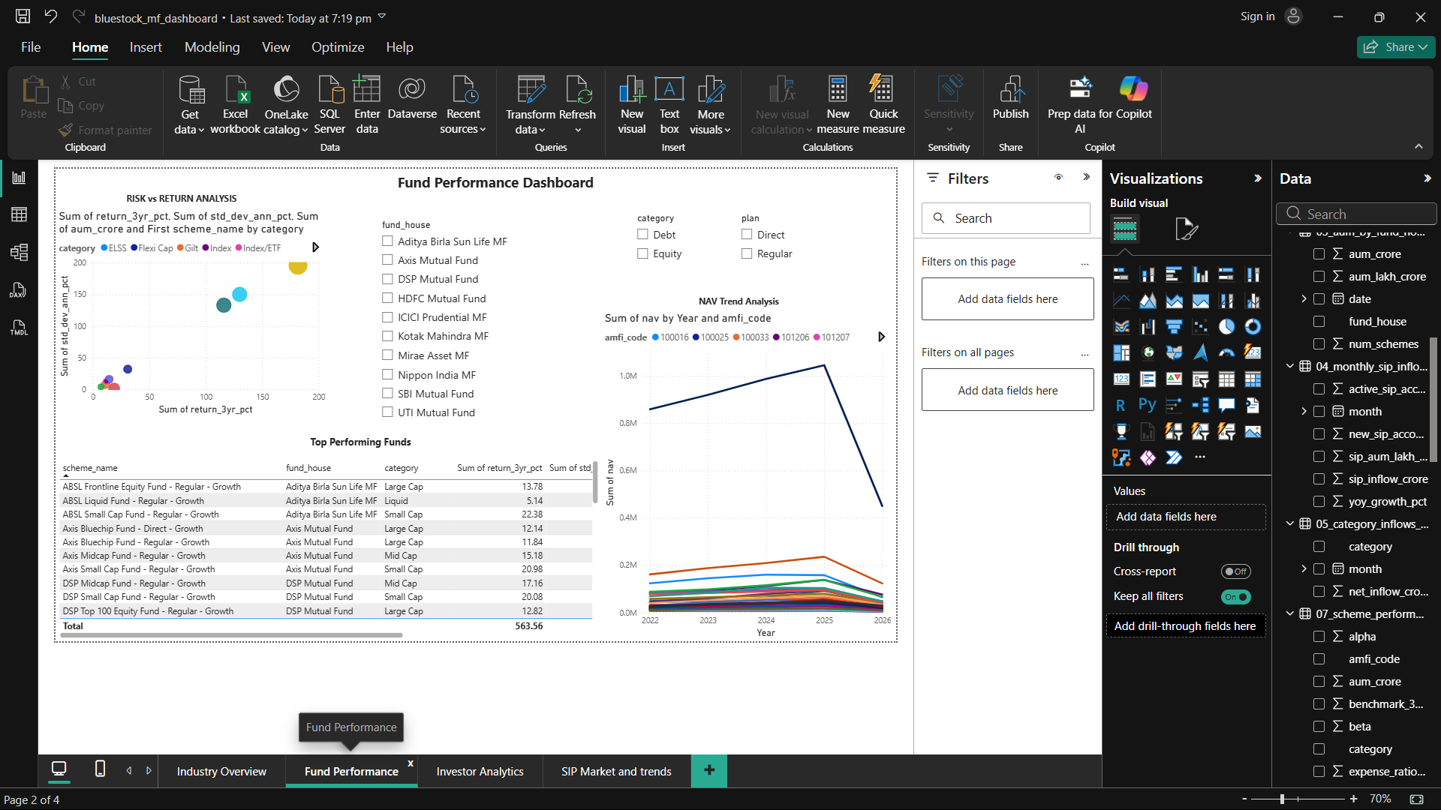
INDUSTRY OVERVIEW
FUND PERFORMANCE

Slide 11
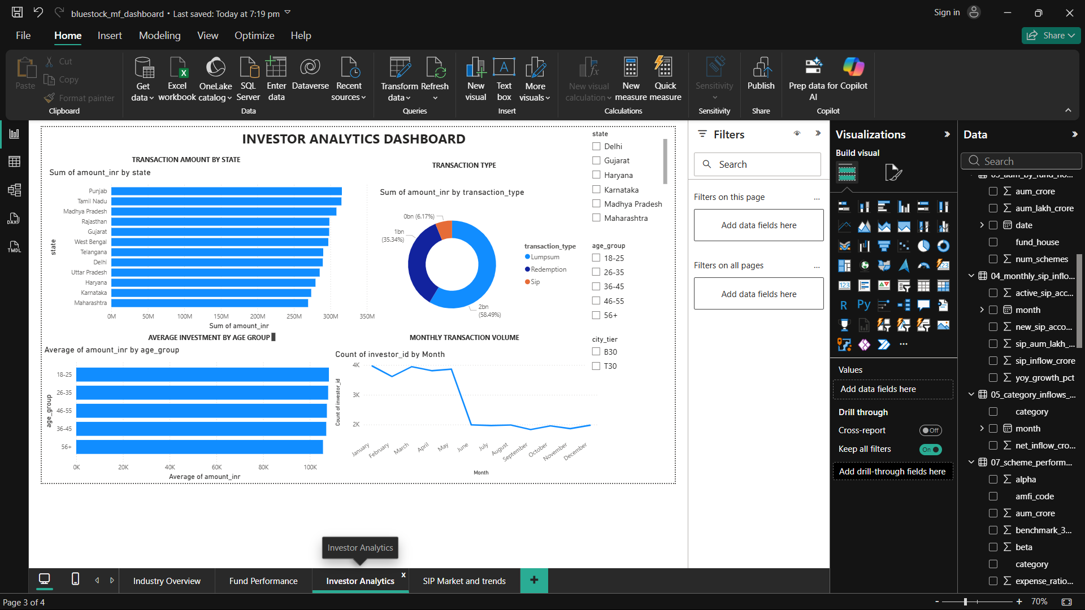
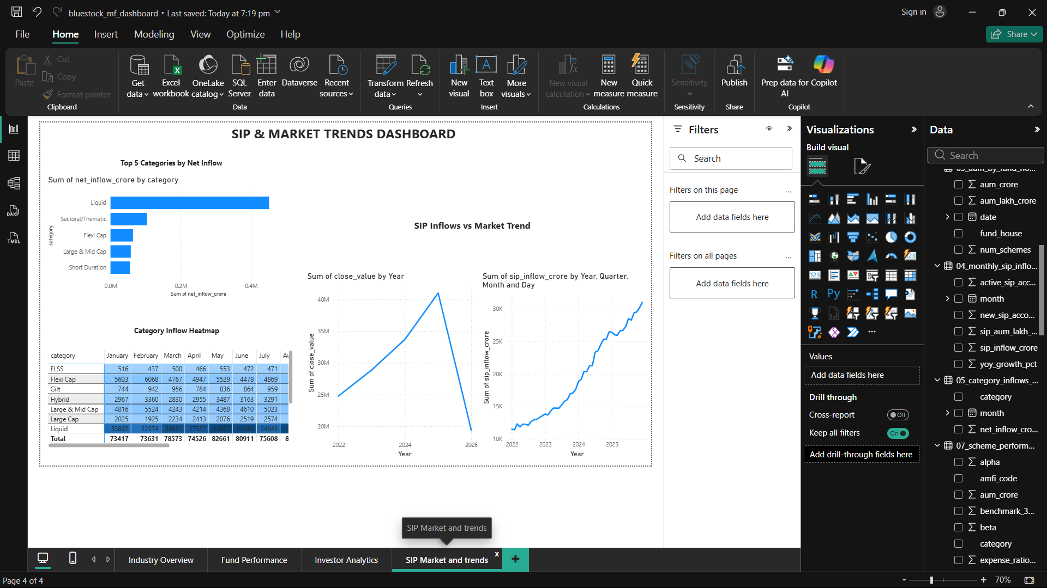
INVESTOR ANALYTICS
SIP MARKET AND TRENDS

Slide 12
CONCLUSIONS
Insights, Recommendations
Key Findings
Recommendations
SBI MF leads the industry in total AUM
SIP inflows peaked in H2 2024
Small-caps carry the highest downside risk
Only 2.20% SIP continuity rate observed
2024 cohort drove majority of investment volume
Deploy SIP nudge campaigns to improve retention
Launch B30 digital-first onboarding strategy
Use composite scorecard for risk-aware fund selection
Diversify portfolios to reduce HHI concentration risk
Thank You
Kevin Joel Velevela | BCA – Data Science | 2026
📧 velevelakevinjoel@gmail.com
PYTHON
SQL
SQLITE
POWER BI
PANDAS
NUMPY
PLOTLY
MATPLOTLIB
ARIMA
SQLALCHEMY

